Slide 1

Apple stock Forecasting
stock market analysis----P403 /group 3
PROJECT GUIDEs:
Karthik
Hareesh
PROJECT members:
Akula Sri Ranganayakula Naidu
Doddapaneni Ganesh
Mr. Sai Likhith Sarabu
Shaik Abdul Rehman
FATHIMA SHIRIN C a
Prajakta Dhananjay Mapari

Slide 2
CONTENTS:
Business Objective
Sdlc methodology
System Architecture
Data set detailes
Eda
Visuvalizations on data
ADF&KPSS tests
Standardization
Model building
Deployment

Slide 3
Business Objective
Stock price prediction is a crucial task in the field of finance and investment.
Understand Stock Trends.
Identify External Influences
Machine learning (ml) techniques have been widely used to analyze and predict stock prices.
Among different ml algorithms, long short-term memory (lstm) has proven to be effective in time-series prediction of stock market prices.
The ML-LSTM model provides an effective approach for stock price prediction.

Slide 4
System Architecture
Raw data
Pre processing of data
Final data set
Rebuilding model
Train data set
LSTM model building and training
Recently predicted values
Test data set
Model testing for prediction
Evaluation of data

Slide 5
DATA SET DETAILS
Dataset Details :-
Number of entries: 2011
Number of columns: 7
Columns:-
Date:- Date of the stock price data.
Open:- Opening price.
High:- Highest price of the day.
Low:- Lowest price of the day.
Close:- Closing price.
Adj Close:- Adjusted closing price.
Volume:- Volume of stocks traded.

Slide 6
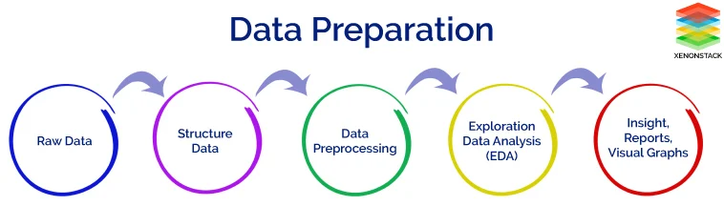
EDA(Exploratory Data Analysis)
Step 1: Understand the Dataset
Step 2: Data Cleaning
Step 3: Univariate Analysis
Step 4: Bivariate Analysis
Step 5: Multivariate Analysis
Step 6: Feature Engineering
Step 7: Data Visualization

Slide 7
Eda results
1. Dataset Overview
Data Source: AAPL.csv
Total Records: 2011
Date Range: 01-Jan-2010 to 31-Dec-2019
Columns: Date, Open, High, Low, Close, Volume, Adj Close
4. Univariate Analysis
Closing Prices:
The distribution of closing prices is right-skewed with most values concentrated around the mean.
Mean Close Price: $65.42
Median Close Price: $57.32
Standard Deviation: $33.78
Volume:
High variability in trading volume with spikes during significant market events.
Mean Volume: ~98 million shares
Median Volume: ~77 million shares
Standard Deviation: ~60 million shares
2. Handling Missing Values
Missing Values: No missing values detected in the dataset.
3. Outlier Detection and Handling
Method: Isolation Forest
Contamination: 0.01 (1%)
Outliers Detected: 21 records marked as outliers
Action Taken: Outliers removed from the dataset

Slide 8
5. Bivariate Analysis:-
Close Price vs Volume:
Weak negative correlation between closing price and trading volume.
Higher volumes do not necessarily correspond to higher prices.
6. Multivariate Analysis:-
Correlation Matrix:
Strong positive correlation between Open, High, Low, and Close prices.
Weak correlation between Volume and price-related columns.
7. Feature Engineering:-
Daily Returns:
New feature created to analyze the daily percentage change in closing prices.
Mean Daily Return: 0.0007
Standard Deviation: 0.017
8. Data standrdization:-
Normalization Method: Min-Max Scaling applied to the 'Close' prices.
Range: Transformed 'Close' prices to the range [0, 1] for model training

Slide 9
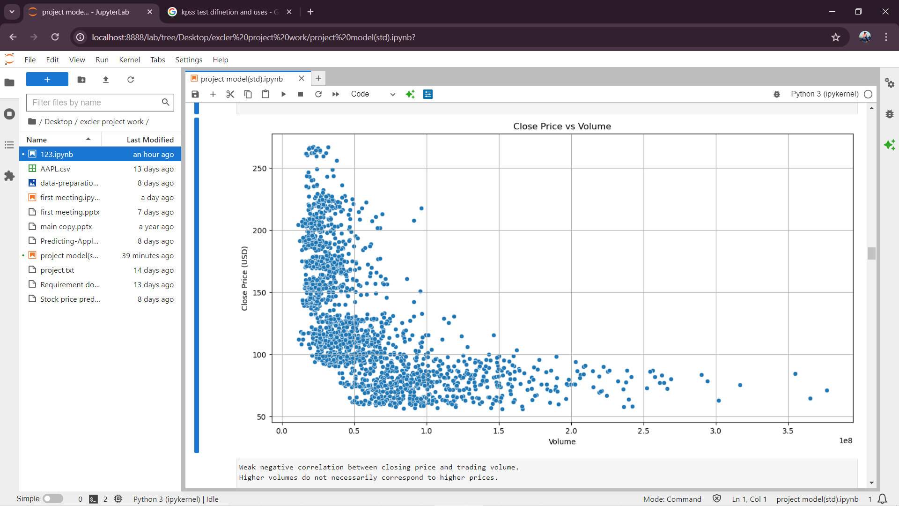
8. Visuvalizations of data:-
Data vizuvalizations are used to give drief explanation of data
It will helping in finding patrenns and good undrstaning of data flow
Following are some of data vizuvalitions

Slide 10
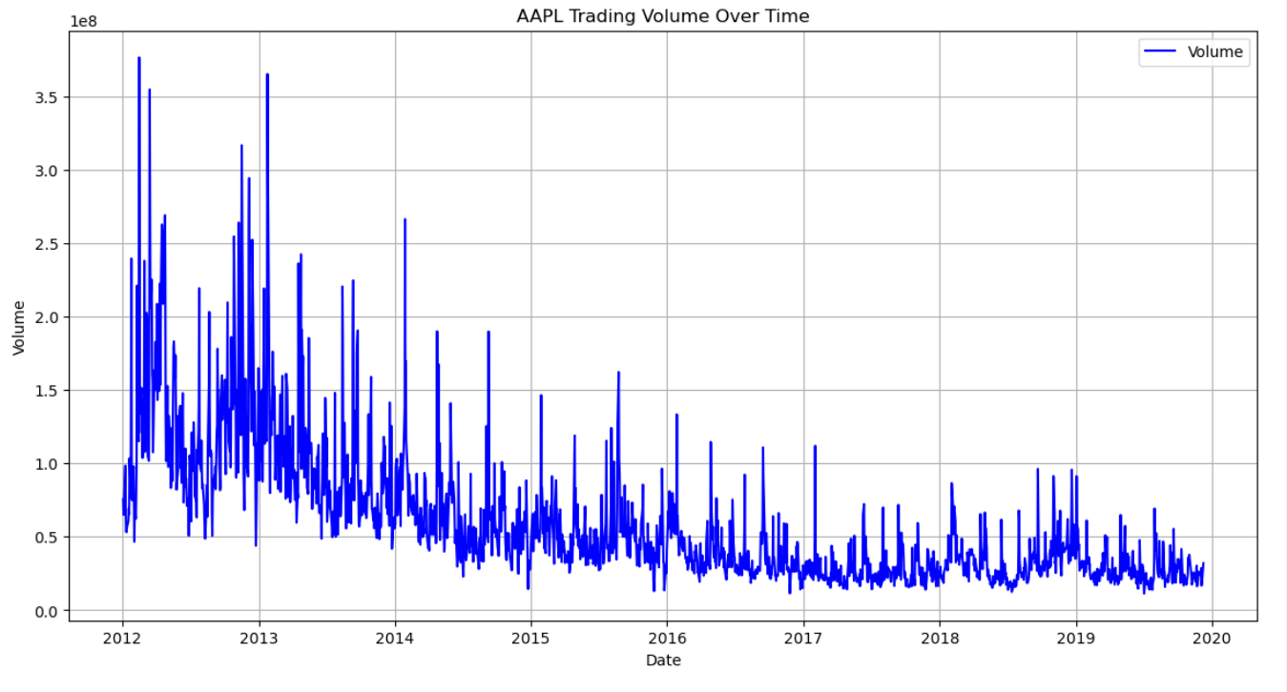

Slide 11
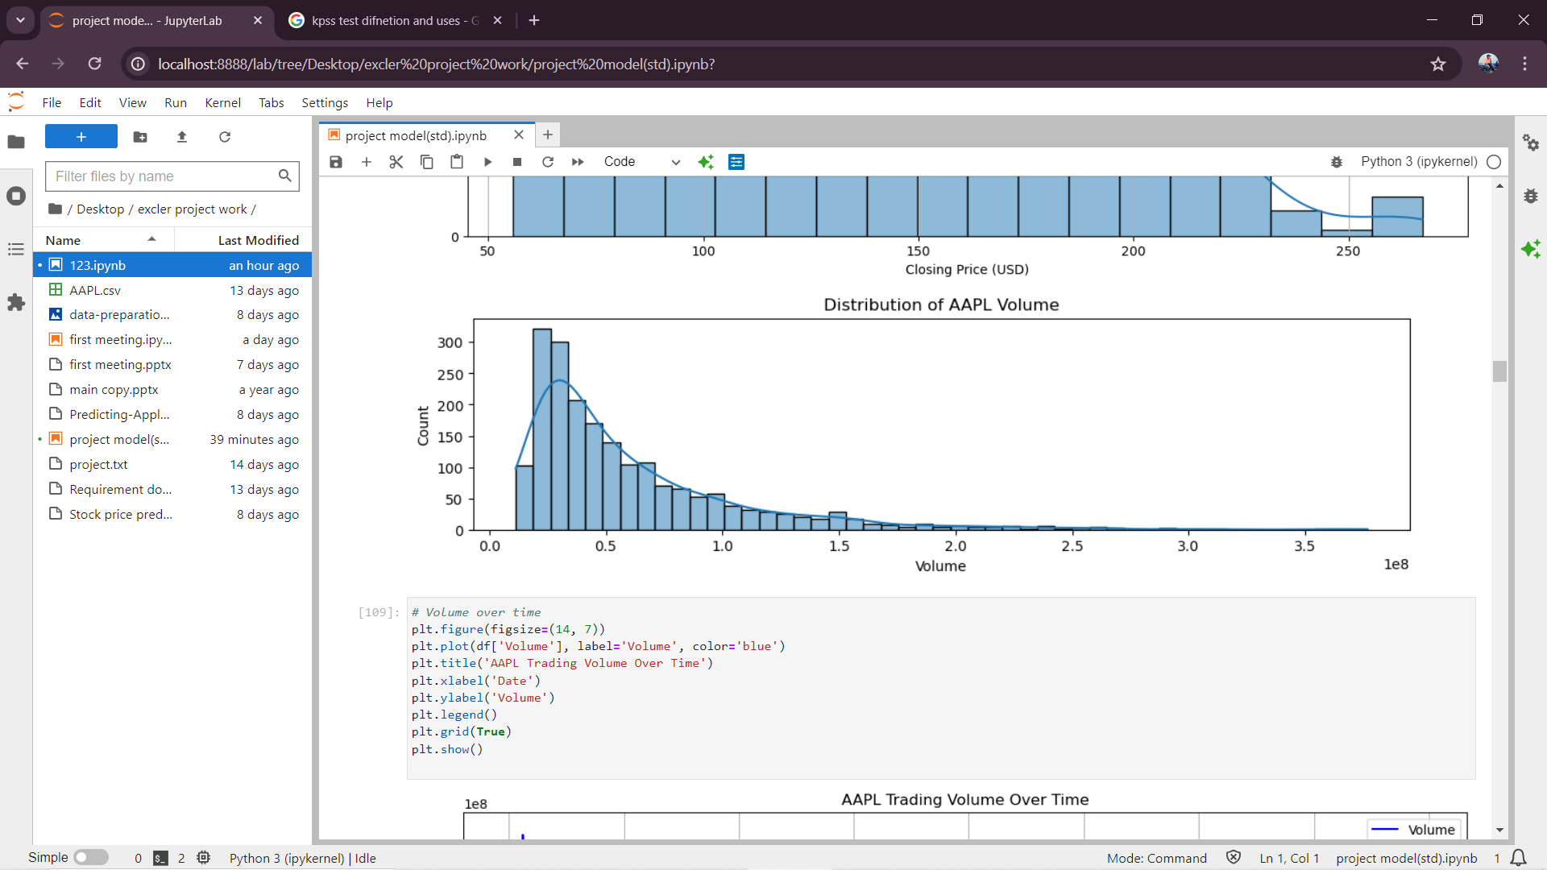

Slide 12
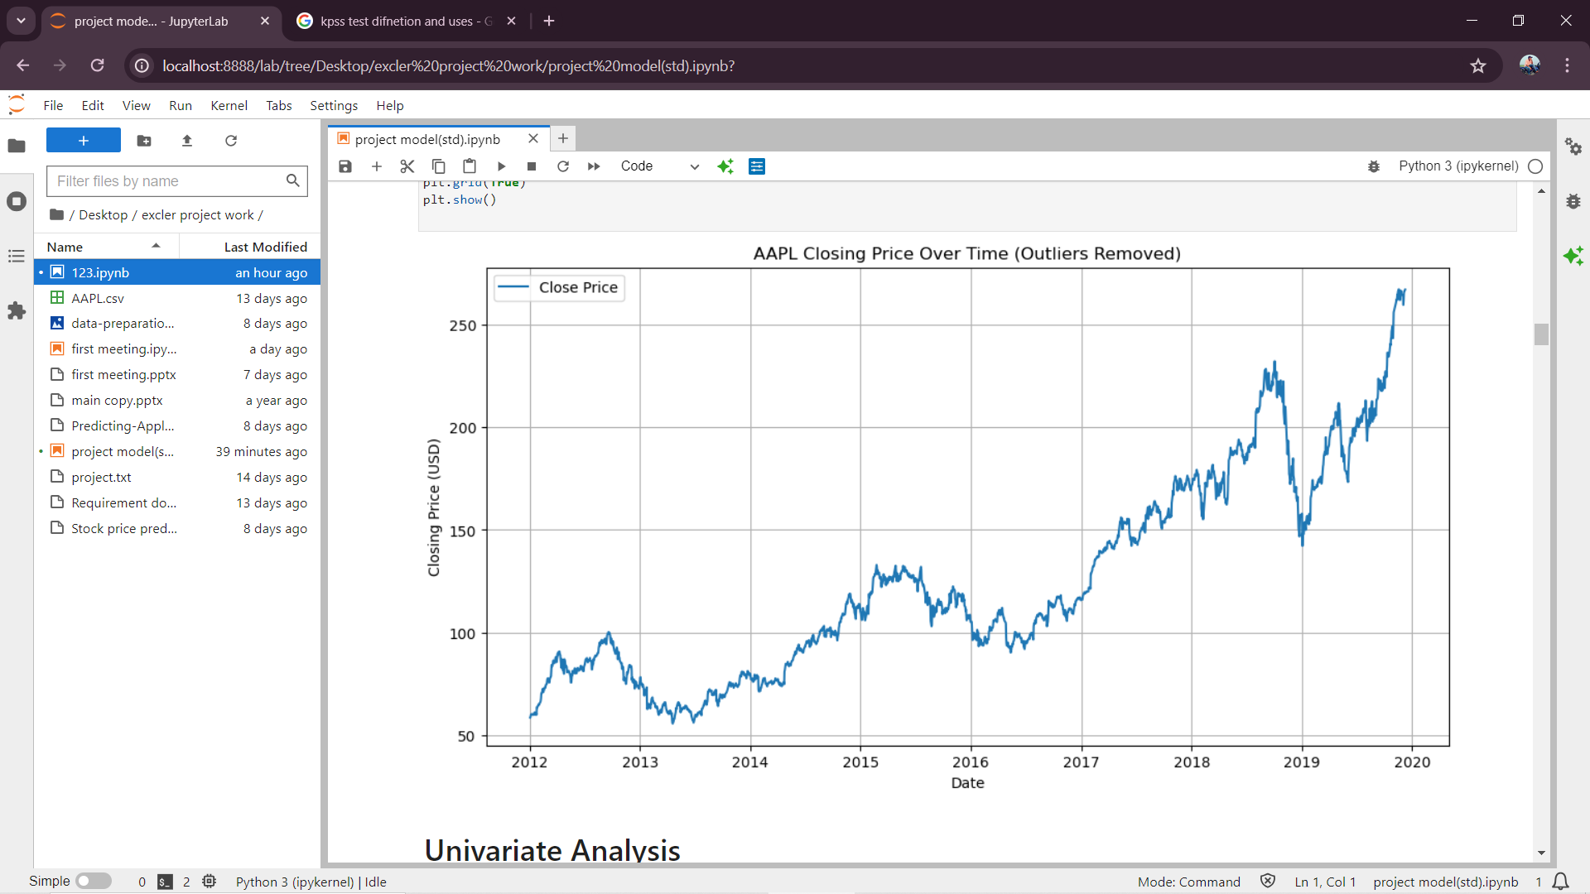

Slide 13
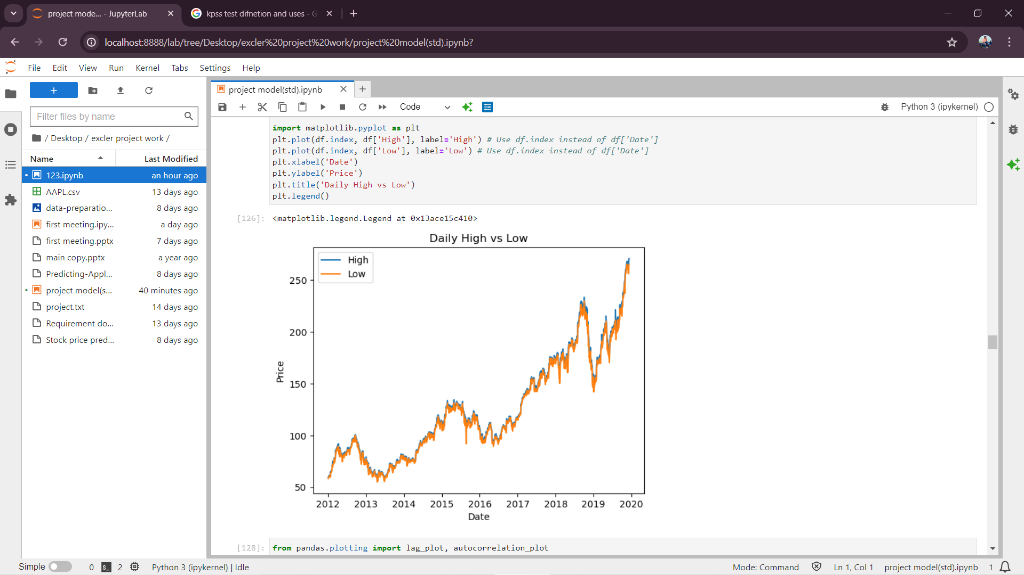

Slide 14
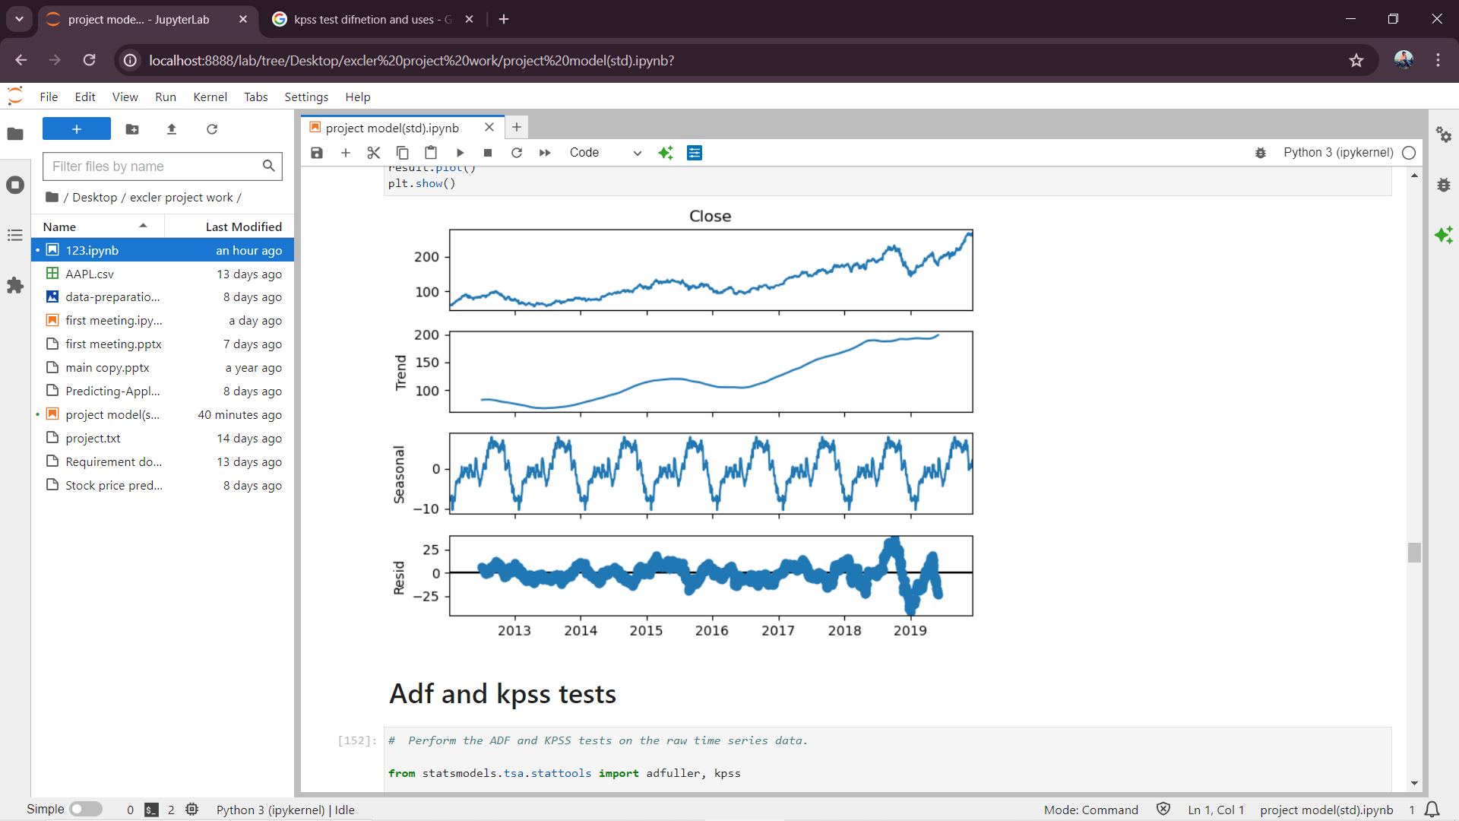
Trends of closing price

Slide 15
9.The ADF (Augmented Dickey-Fuller) test:-
The ADF (Augmented Dickey-Fuller) test is used to see if a time series is stationary.
Here's how to interpret the results: The Hypothesis: The test has a null hypothesis that the data has a unit root, which means it's not stationary.
The alternative hypothesis is that the data is stationary or trend-stationary.
10. Kpss test:-
The KPSS test, short for, Kwiatkowski-Phillips-Schmidt-Shin (KPSS).
is a type of Unit root test that tests for the stationarity of a given series around a deterministic trend.
In other words, the test is somewhat similar in spirit to the ADF test.
11. standardization:-
Data standardization is a data processing workflow that converts the structure of different datasets into one common format of data.
It deals with the transformation of datasets after the data are collected from different sources and before it is loaded into target systems.

Slide 16
After applying standardization
Summary of Results:
ADF Test:
ADF Statistic: -13.626 Before:ADF Statistic: 0.5929875922244102
p-value: 1.7631e-25 Before :p-value :-0.986947845844
Interpretation: The p-value is extremely small (far less than 0.05), which means we reject the null hypothesis of a unit root. This suggests that the time series is stationary according to the ADF test.
KPSS Test:
KPSS Statistic: 0.24616 before KPSS Statistic:5.96847854584221
p-value: 0.1 Before P-value :-0.01
Interpretation: The p-value is relatively high (greater than 0.05), which means we fail to reject the null hypothesis of stationarity around a deterministic trend. This further confirms that the time series is stationary according to the KPSS test.
Conclusion:
Yes, the data is stationary.
This conclusion is derived from the results of both the ADF and KPSS tests, which collectively confirm the stationarity of the time series.

Slide 17
LSTM Model
Train Score: 4.005078057732966 RMSE
Test Score: 5.863188020295062 RMSE
Train R²: 0.9904608337828202
Test R²: 0.9376118592015867
Predictions for the next 30 days:
Day 1: 256.1569519042969
Day 2: 255.2490997314453
Day 3: 254.20848083496094
Day 4: 253.12591552734375
Day 5: 252.05772399902344
Day 6: 251.03500366210938
Day 7: 250.0726318359375
Day 8: 249.1766357421875
Day 9: 248.34774780273438
Day 10: 247.5840301513672
Day 11: 246.8820343017578
Day 12: 246.23785400390625
Day 13: 245.64720153808594
Day 14: 245.1059112548828
Day 15: 244.61004638671875
Day 16: 244.15579223632812
Day 17: 243.73971557617188
Day 18: 243.35855102539062
Day 19: 243.0093536376953
Day 20: 242.68943786621094
Day 21: 242.39627075195312
Day 22: 242.1276092529297
Day 23: 241.88137817382812
Day 24: 241.65567016601562
Day 25: 241.4487762451172
Day 26: 241.25909423828125
Day 27: 241.0851593017578
Day 28: 240.92567443847656
Day 29: 240.7794189453125
Day 30: 240.6453094482422

Slide 18
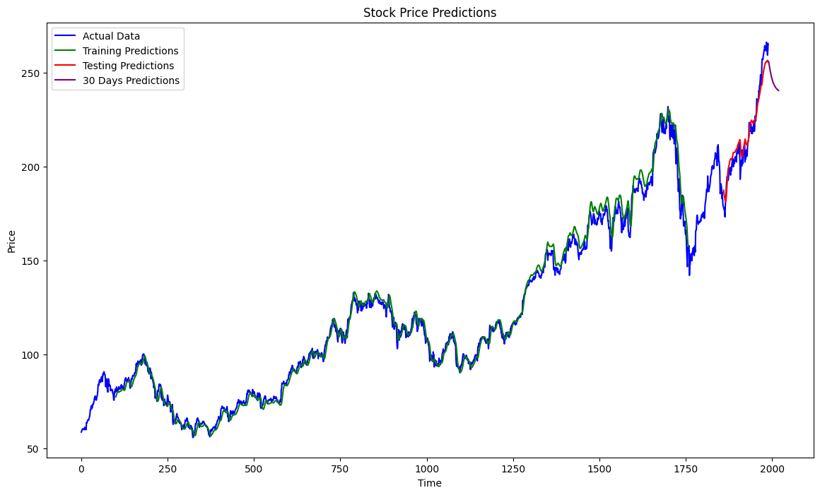
LSTM Model

Slide 19
ARIMA Model
RMSE: 2.4918234331333564
R²: 0.9973526787718372
Predictions for the next 30 days:
Day 1: 266.7031447158607
Day 2: 266.6001543376136
Day 3: 266.6013528135186
Day 4: 266.60753538315265
Day 5: 266.6081576049743
Day 6: 266.6078642261978
Day 7: 266.6077948191475
Day 8: 266.60780427303536
Day 9: 266.60780940817443
Day 10: 266.6078094282424
Day 11: 266.6078091289195
Day 12: 266.6078090942092
Day 13: 266.6078091078991
Day 14: 266.6078091114711
Day 15: 266.6078091110673
Day 16: 266.6078091108123
Day 17: 266.60780911080747
Day 18: 266.6078091108219
Day 19: 266.6078091108238
Day 20: 266.60780911082315
Day 21: 266.607809110823
Day 22: 266.607809110823
Day 23: 266.607809110823
Day 24: 266.607809110823
Day 25: 266.607809110823
Day 26: 266.607809110823
Day 27: 266.607809110823
Day 28: 266.607809110823
Day 29: 266.607809110823
Day 30: 266.607809110823

Slide 20
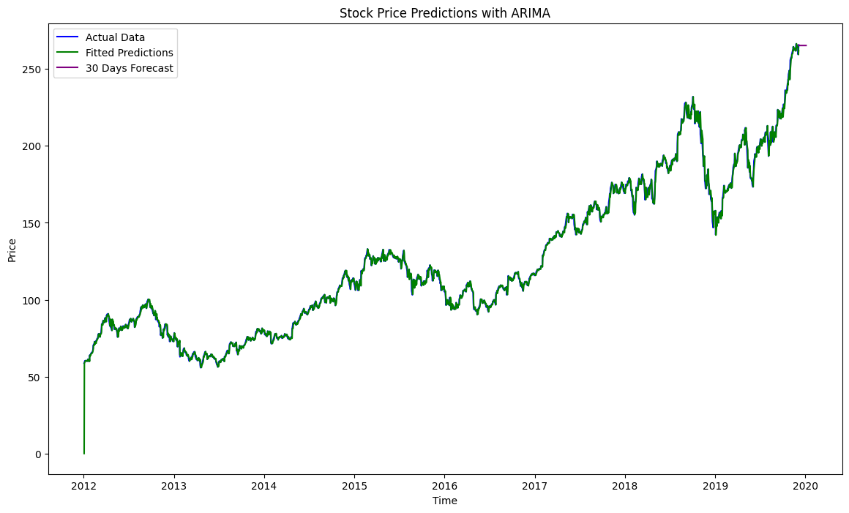

Slide 21
GATED RECURRENT UNIT
Bidirectional LSTM Model(BiLSTM)
Train Score: 2473.675962567261 RMSE
Test Score: 6364.16352445738 RMSE
Train R²: -1.163666144853087
Test R²: -26.458218328548547
Train Score: 8757768.231163299 RMSE
Test Score: 15299003.487922141 RMSE
Train R²: -8.601500722036164
Test R²: -84.16242526837488
CNN Model
TEMPORAL CONVOLUTIONAL NETWORKS (TCN)
Train Score: 358473444.04937893 RMSE
Test Score: 626211356.9564492 RMSE
Train R²: -8.569804650661666
Test R²: -83.87904513888272
Train Score: 19335.494840265204 RMSE
Test Score: 27418.48444896289 RMSE
Train R²: 0.9213269597178926
Test R²: 0.5401970508852643

Slide 22
Deployment steps
Selected floatfoam is streamlit
Creating vertuval environment
Instlling reqired packages
Rooting codes and files based on reqiremts
Web deployment
Project maintnace

Slide 23
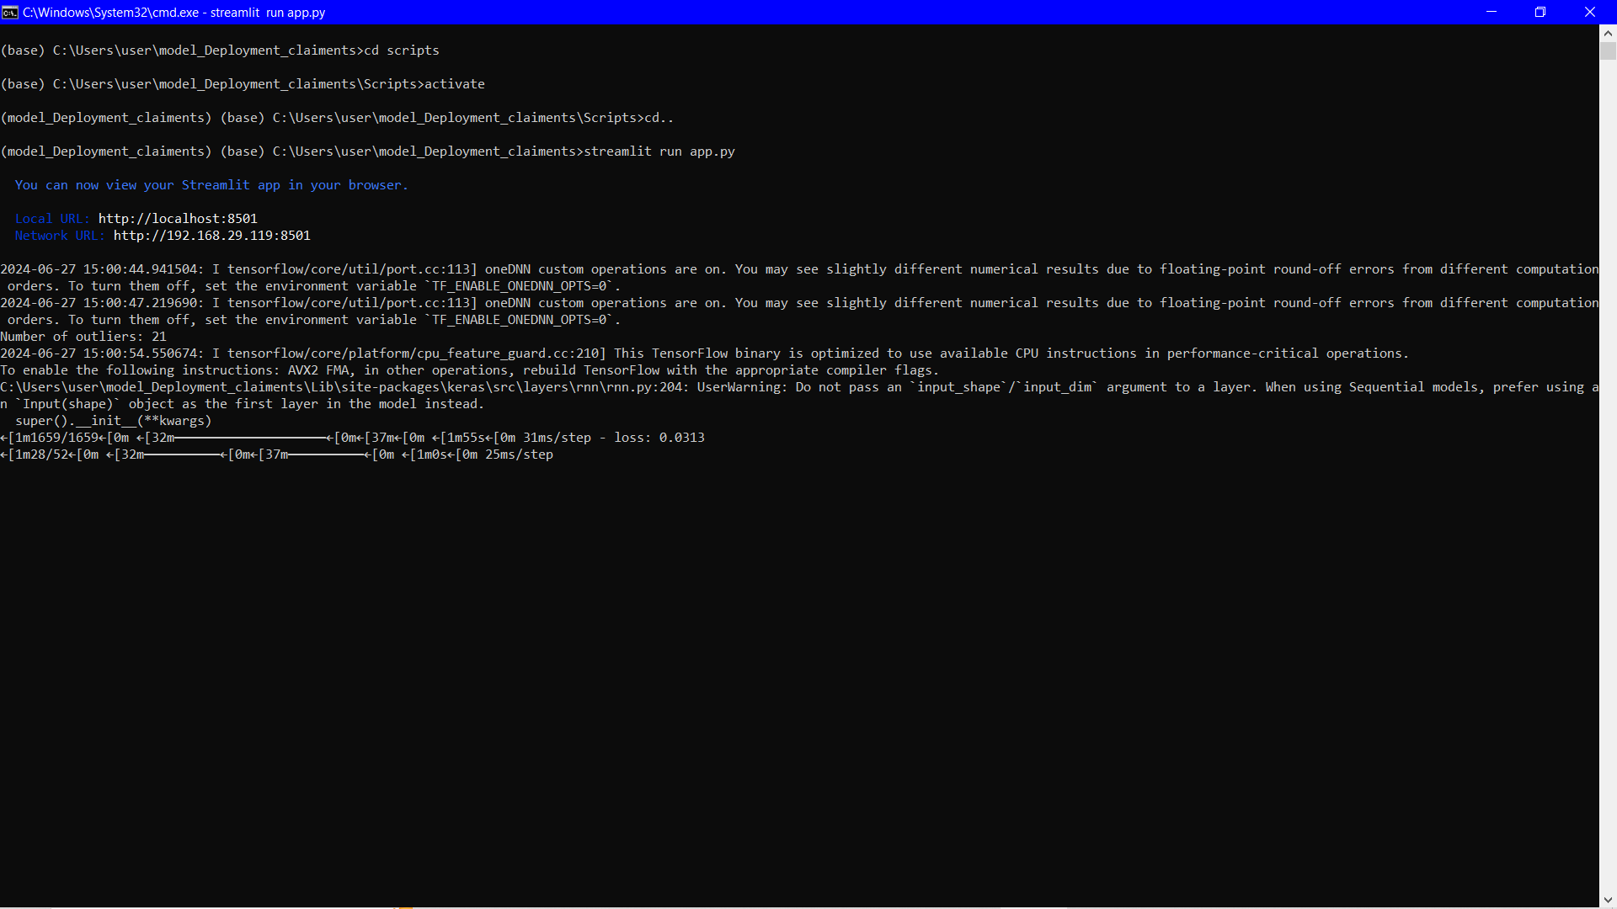
Deployment

Slide 24
Challenges and Resolutions
Challenge: Data Loading and Formatting
Problem: Incorrect date format or missing values could lead to issues when processing the data.
Resolution: The code converts the 'Date' column to datetime format and sorts the data by date, ensuring it is correctly formatted and ready for analysis.
Challenge: Handling Outliers
Problem: Outliers in the dataset can skew the results and affect the performance of the model.
Resolution: An Isolation Forest algorithm is used to detect and remove outliers, ensuring
cleaner dataset for analysis.
Challenge: Data Stationarity
Problem: Non-stationary data can lead to poor performance of time series models.
Resolution: Differencing is applied to the 'Close' price series to achieve stationarity, which is a common preprocessing step in time series analysis.
Challenge: Data Standardization
Problem: Differences in scale between training and testing data can affect model performance.
Resolution: The data is standardized using StandardScaler to ensure that the model receives data with a mean of 0 and standard deviation of 1, which helps in improving model performance.

Slide 25
Challenges and Resolutions
Challenge: Data Partitioning
Problem: Incorrect splitting of training and testing data can lead to data leakage or inadequate training.
Resolution: The data is split into training and testing sets based on the year, ensuring a clear separation between the training and testing phases.
Challenge: Model Building
Problem: Choosing an appropriate model architecture for time series forecasting can be complex.
Resolution: The code uses an LSTM model, which is well-suited for time series data, ensuring that the model can capture temporal dependencies.
Challenge: Model Evaluation
Problem: Evaluating the model’s performance on unseen data is crucial for understanding its effectiveness.
Resolution: The model’s performance is evaluated using metrics such as mean squared error (MSE) and R-squared (R²) score, providing insights into how well the model is performing.
Challenge: User Interface Integration
Problem: Displaying results and user interaction can be challenging in a web application.
Resolution: The code uses Streamlit for creating an interactive web interface, making it easier for users to visualize results and interact with the application.

Slide 26
Thank you

